Slide 1
Agenda for GEOG260/360 GIS & Land Change Models
October 25
Get instructions for Assignment 8
October 30
Discuss Assignment 8
November 1
Submit Assignment 8 by 4pm on Canvas
Get instructions for Project Proposal
November 6
Discuss Project Proposals
November 8
Submit Project Proposal by 4pm on Canvas

Slide 2
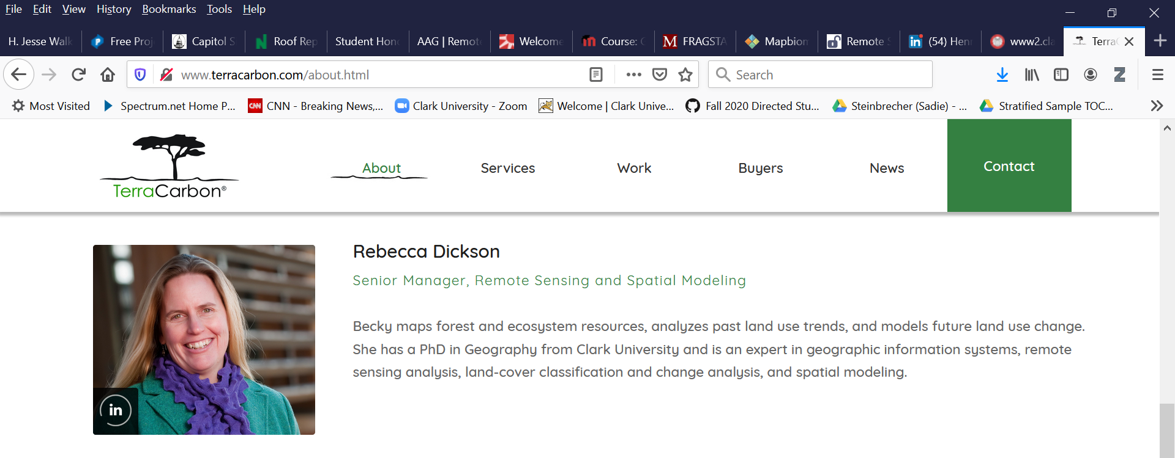
https://www.terracarbon.com/team

Slide 3
Steps to show effectiveness of forest protection to award carbon credits
Demonstrate that your model extrapolates the baseline accurately.
Use a simulation model to extrapolate forest loss assuming no protection, which is called the baseline.
Protect part of the region from deforestation.
Wait six years, then award a carbon credit for forest persistence in the part of the protected region that the simulation extrapolated forest loss.
Delete from the carbon credit any leakage. Leakage occurs when the protection inspires people to deforest elsewhere, thus negating the effectiveness of the protection.

Slide 4
The Voluntary Carbon Standard rule specifies:
“The minimum threshold for the best fit as measured by the Figure of Merit (FOM) shall be defined by the net observed change in the reference region for the calibration period of the model. Net observed change shall be calculated as the total area of change being modeled in reference region during the calibration period as percentage of the total area of the reference region. The FOM value shall be at least equivalent to this value.”
Figure of Merit = FOM = Hits / (Misses + Hits + False Alarms)
The simulation model qualifies when
Figure of Merit > |Forest Loss during calibration|/Forest Start Size

Slide 5
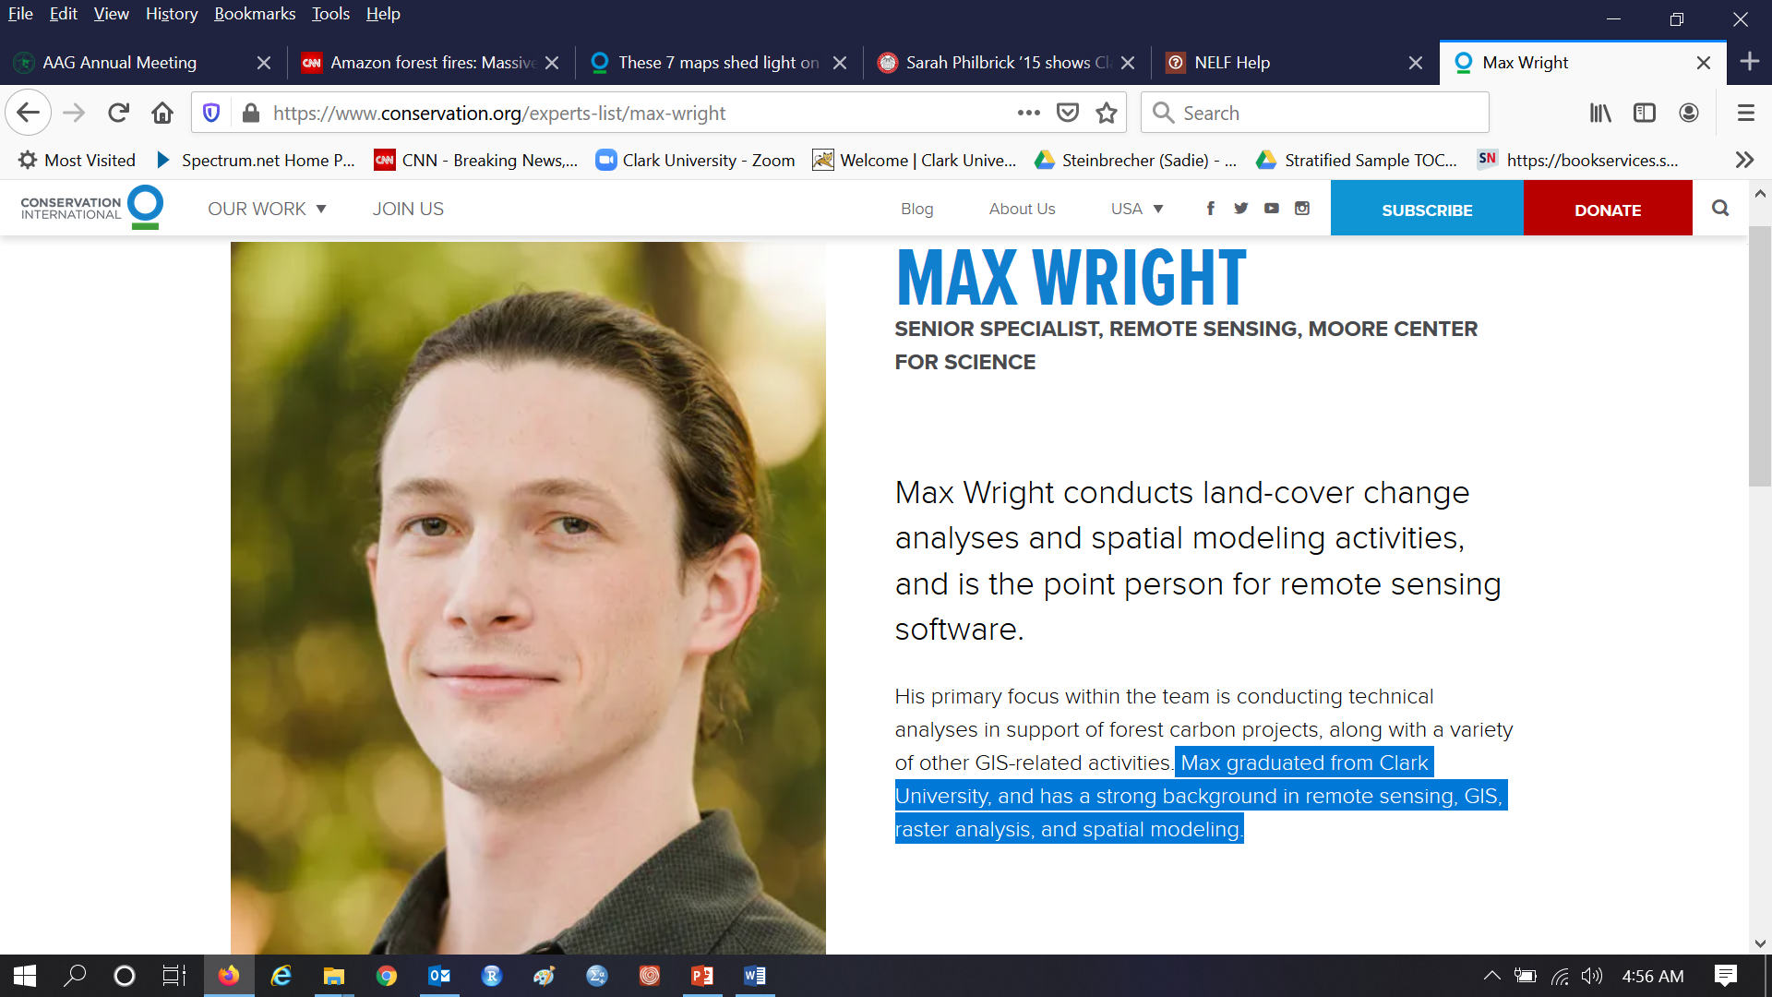
Max Wright works for Conservation International, which sees REDD+ as an opportunity to conserve biodiversity https://www.conservation.org/experts-list/max-wright
https://www.conservation.org/blog/these-7-maps-shed-light-on-most-crucial-areas-of-amazon-rainforest

Slide 6
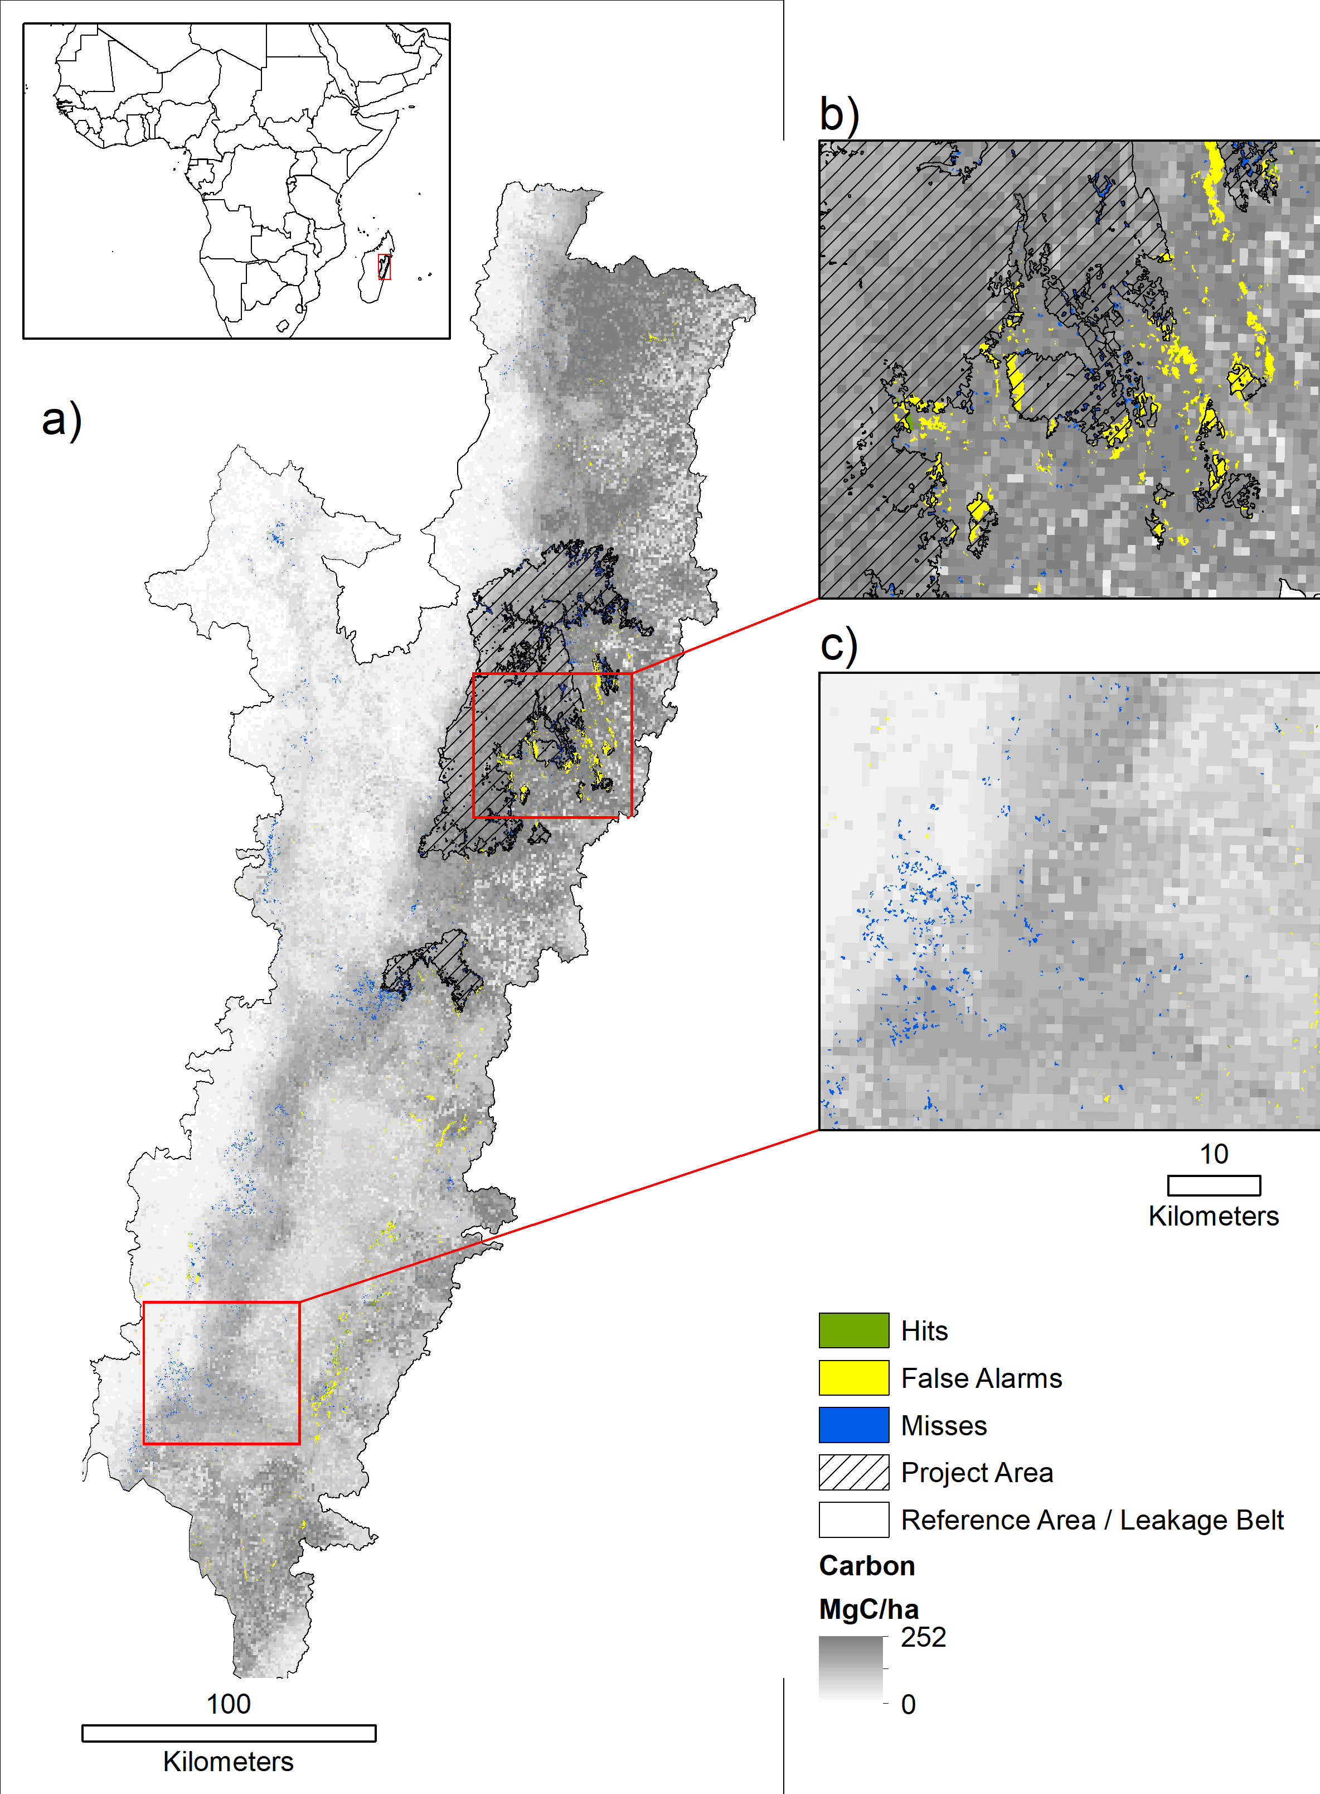
Reducing Emissions from Deforestation and Forest Degradation (REDD) Madagascar data are from Max Wright at Conservation International This is a collaboration with Professor Florencia Sangermano Project area is the protected area.

Slide 7
Assignment 8
Download redd2.zip from Canvas. Use RECLASS to make the following three maps where 1=Forest and 2=Non-Forest for 2005cover, 2010cover, and 2013cover. Create a distance from non-forest at 2005 where the forest at 2005 has positive distances. Make a constraint map where Project is 0 and else is 1.
Perform three simulations where calibration interval is 2005-2010. Use distance to 2005 Forest edge as a static variable for all runs. Use MLP to create the transition potential maps.
Include five slides. Slide 1 is a title slide. Slide 2 presents the baseline simulation in a manner that distinguishes deforestation inside project from deforestation outside project. Slide 3 presents the constrained simulation. Slide 4 compares the baseline simulation to the project simulation. Slide 5 shows and explains the third simulation in terms of the figure of merit during validation and the proportion of forest loss during calibration.
The first two simulations extrapolate to the year 2040 using the same transition potential map. The first simulation is the baseline simulation that uses no constraints. The second simulation is a constrained simulation that prevents deforestation in the project area. Use CROSSTAB for your slide 4 to compare the two simulations, labeling each combination appropriately in terms of REDD, specifically Forest Persistence, Avoided Deforestation, Possible Leakage, and Forest Loss Both Scenarios, and Non-Forest at 2005.
The third simulation extrapolates to the year 2013. Show a validation map. Report the number of Misses, Hits, False Alarms, then compute the figure of merit. Compare the value of the figure of merit to the proportion of forest loss during the calibration interval. State whether the model qualifies for a REDD project according to the VCS standard. If the project does not qualify, then state your options for modifying the procedure to make the model to qualify.

Slide 8
Rubrics for assignment 8
Submit exactly one slide with your name(s). 5 points
Submit exactly one slide that shows baseline simulation in a manner that distinguishes deforestation inside project from deforestation outside project. 20 points
Submit exactly one slide which includes constrained simulation. 15 points
Submit exactly one slide which includes following bullets: 30 point
Map that shows comparison between baseline simulation with the project simulation. 20 points
Sentences that helps to understand the comparison of baseline simulation with the project simulation. 10 points
Submit exactly one which includes the following bullets: 25 points
Map of third simulation. 15 points
Sentences that explains the third simulation in terms of the figure of merit during validation and the proportion of forest loss during calibration. 10 points
Bonus. 5 points

Slide 9
Assignment 8 starts with this map called redd1

Slide 10
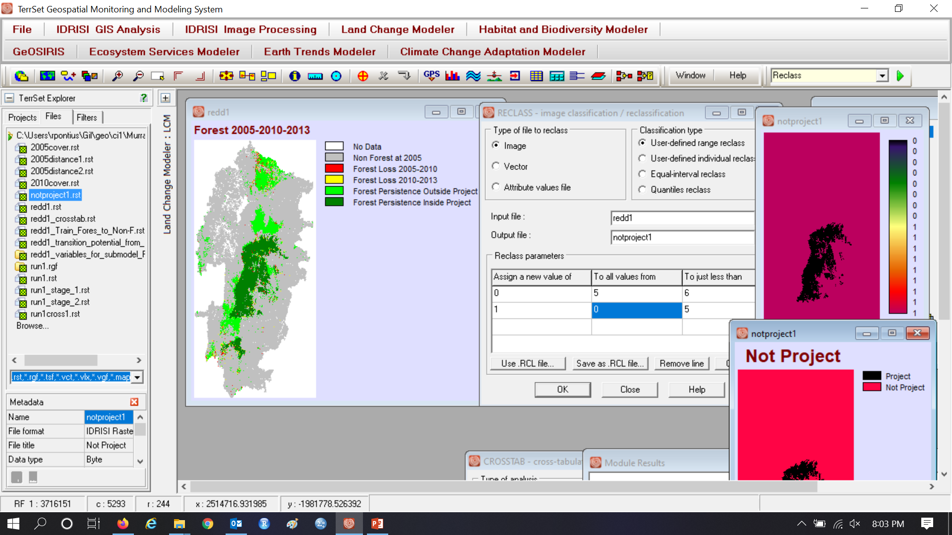
Use RECLASS to make a Boolean map of Inside Project where 0 means Protected

Slide 11
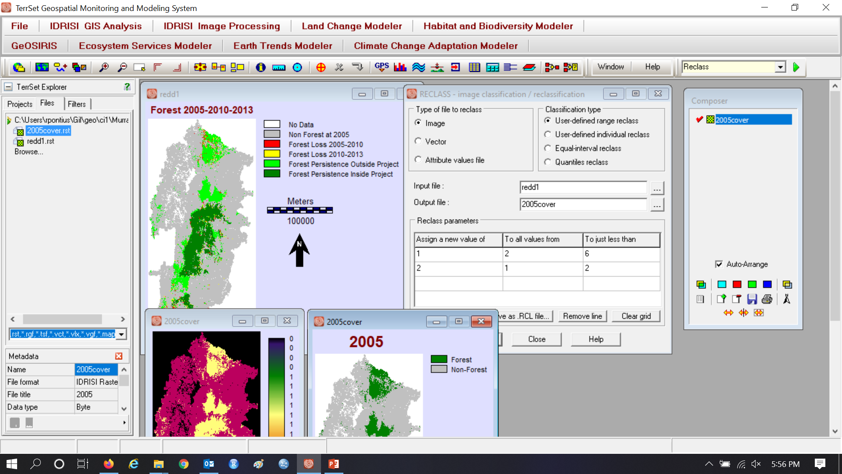
Use RECLASS to make a map of Forest at 2005

Slide 12
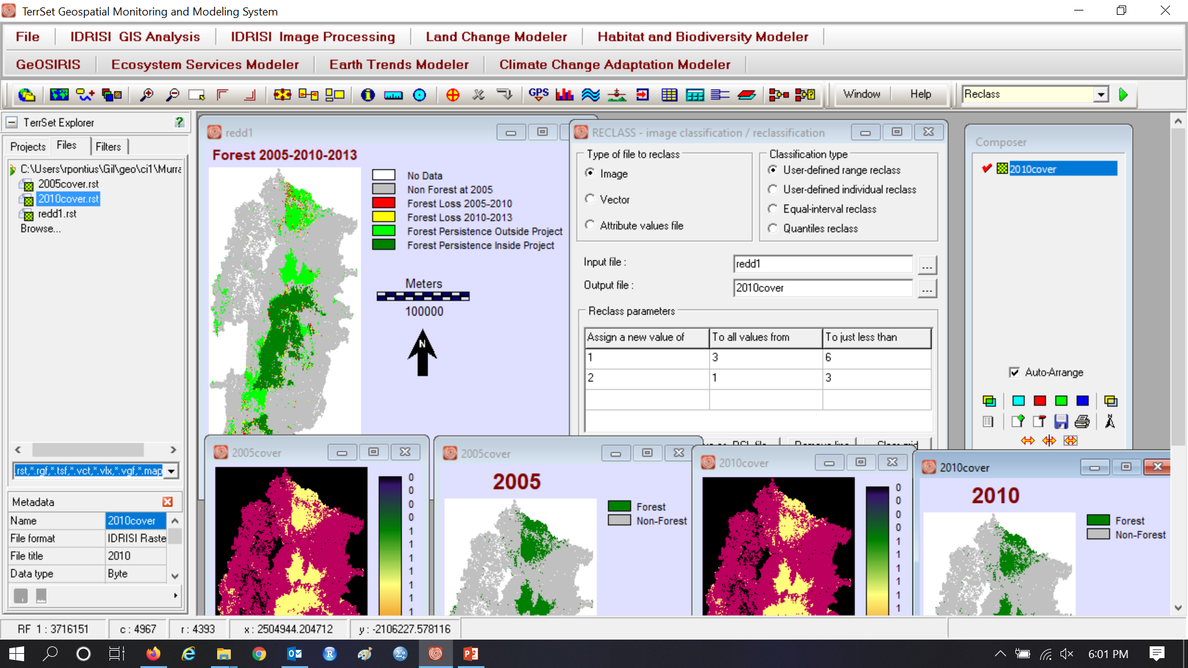
Use RECLASS to make a map of Forest at 2010

Slide 13
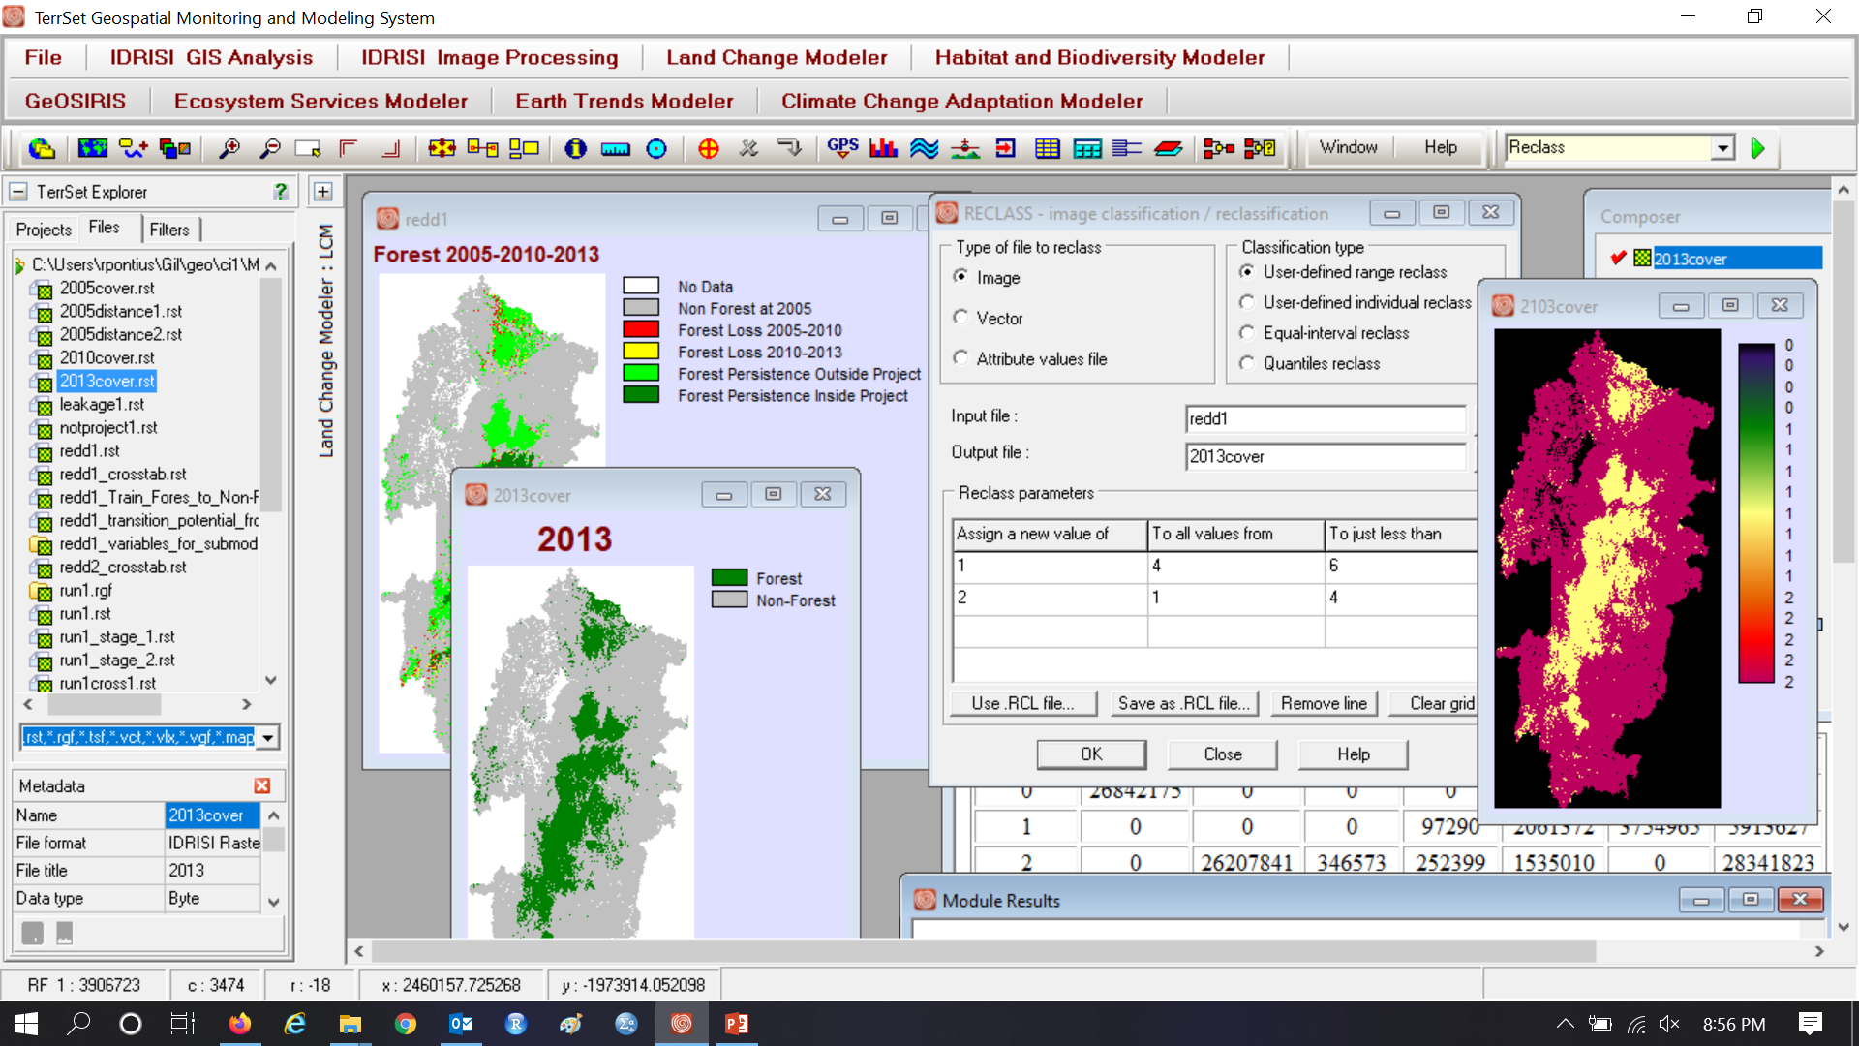
Use RECLASS to make a map of Forest at 2013

Slide 14
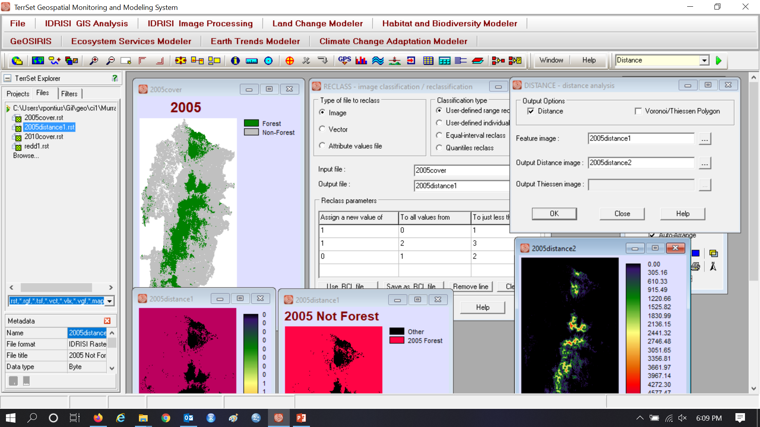
Make Distance to 2005 Non-Forest
Forest
Other

Slide 15
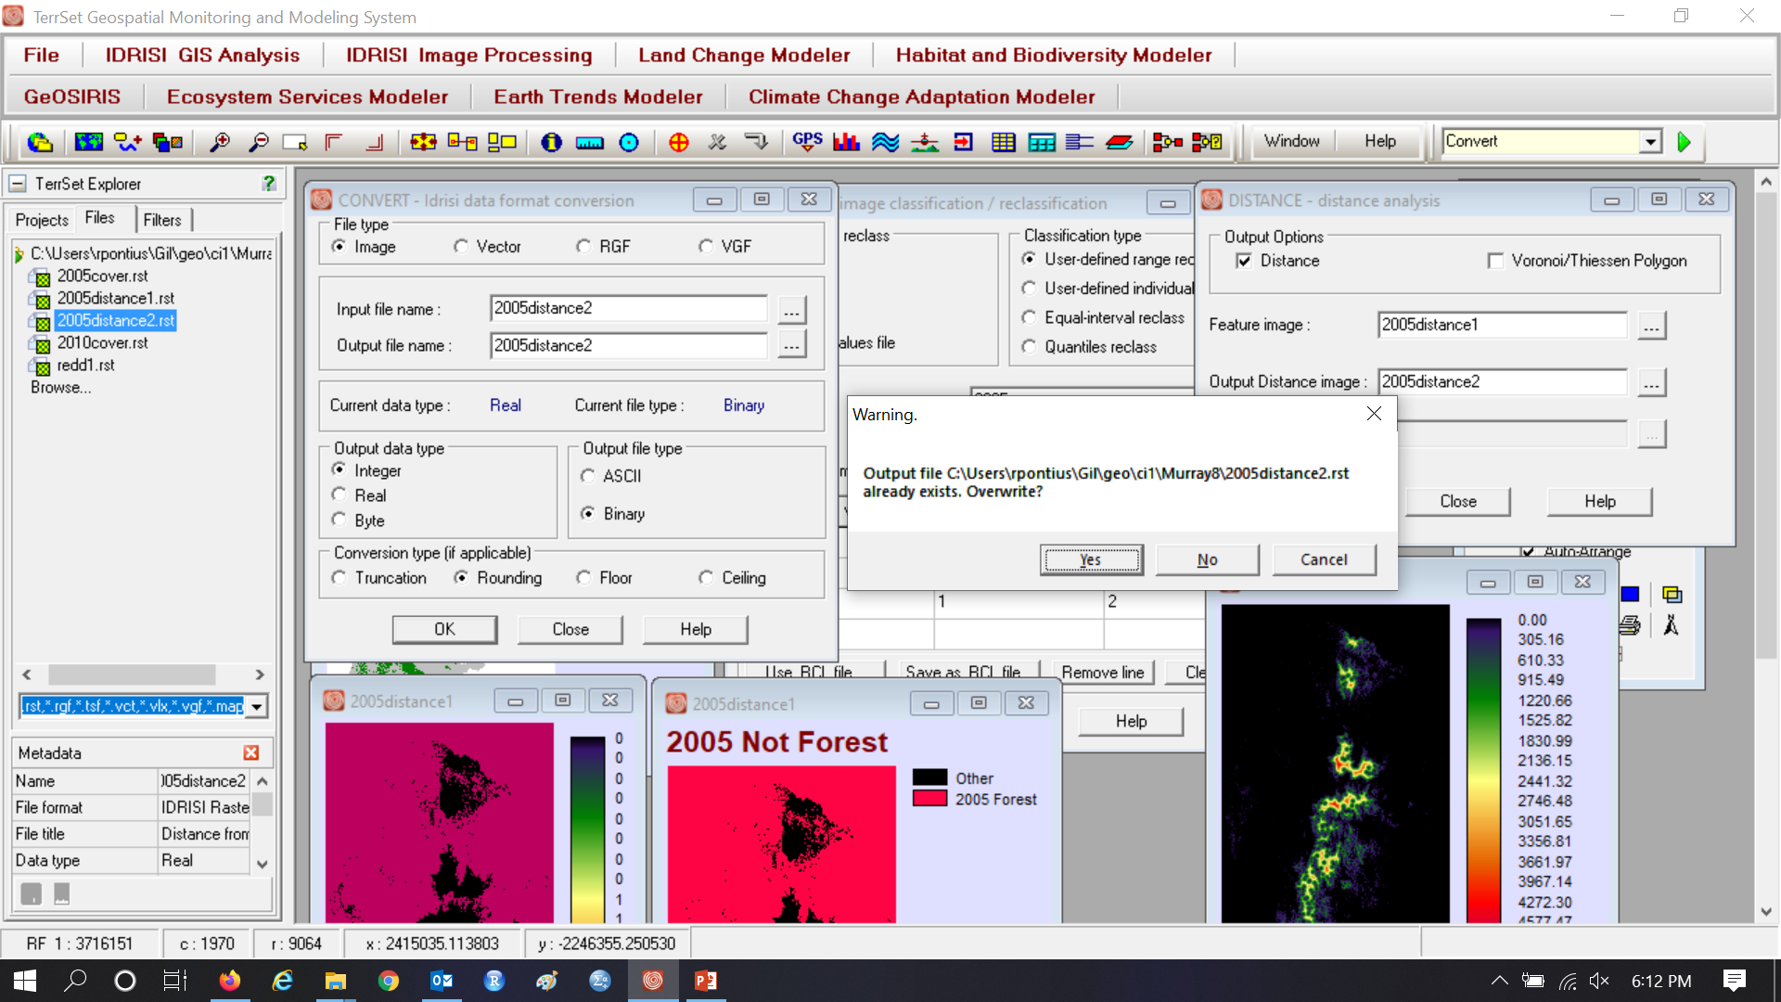
Use CONVERT to integer to shrink file size

Slide 16
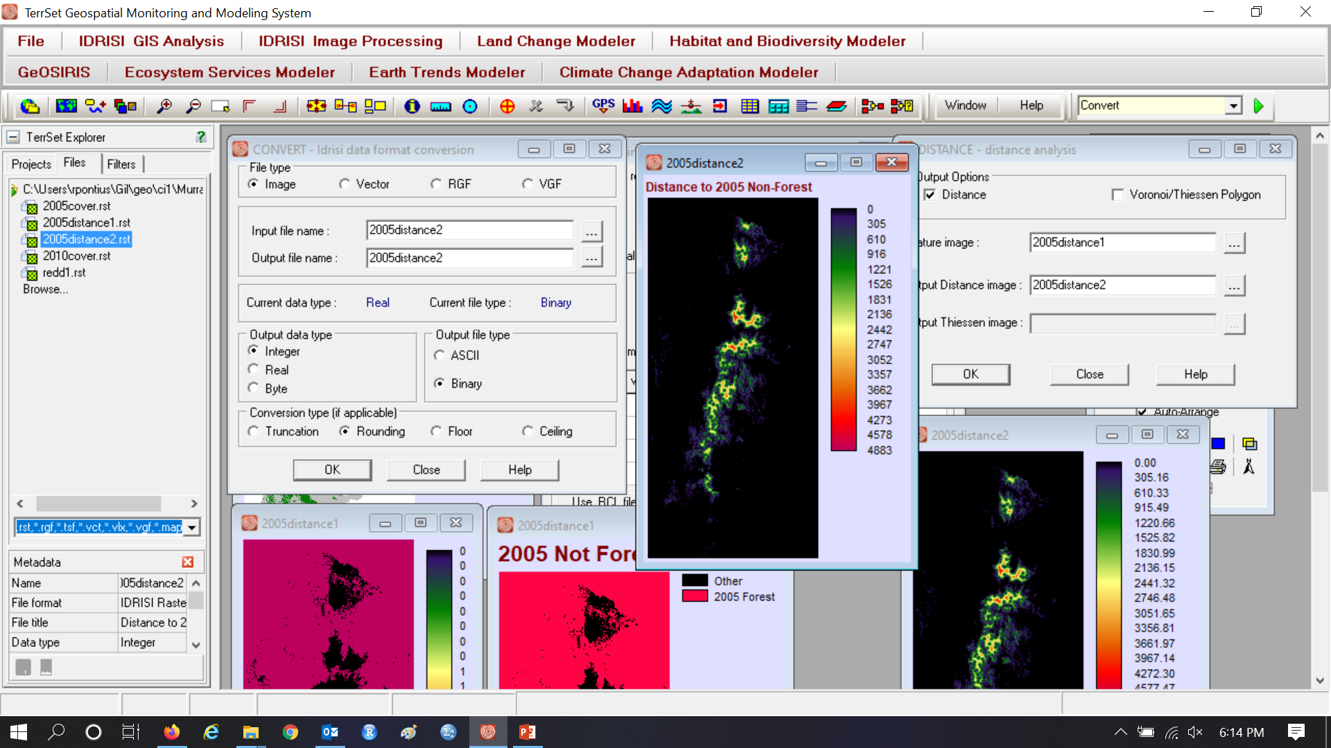
CONVERT makes Integer Map of Distance to Edge

Slide 17
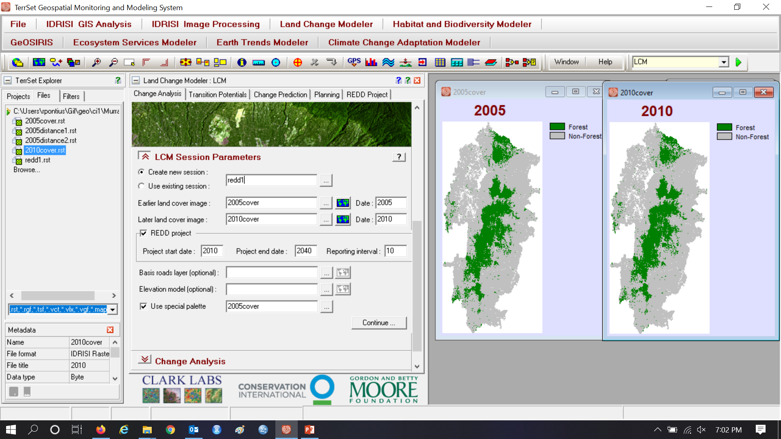
Check REDD project with end date 2040 and interval 10

Slide 18
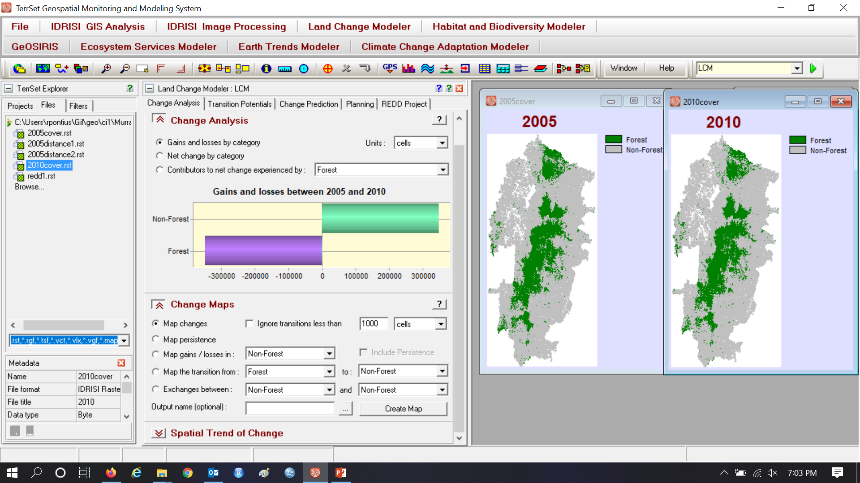
Assignment 8

Slide 19
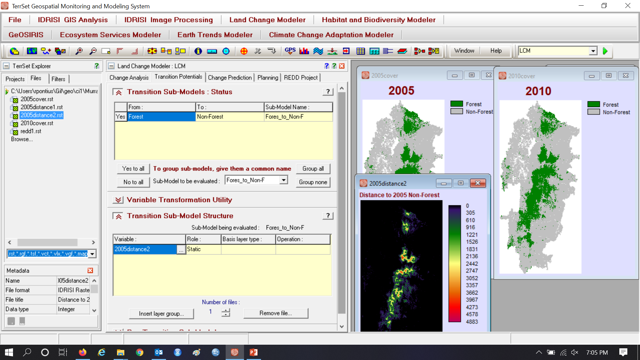
Assignment 8

Slide 20
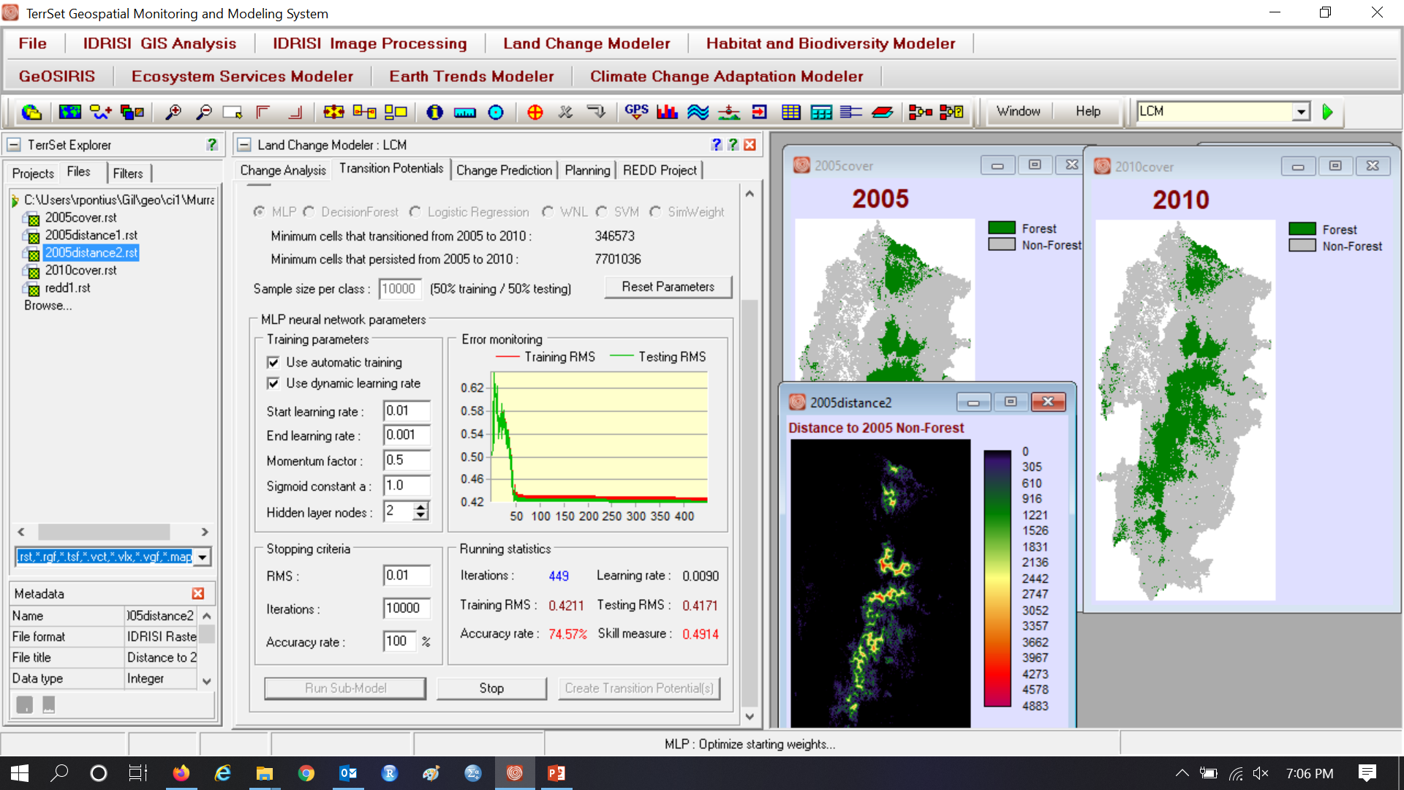
Assignment 8

Slide 21
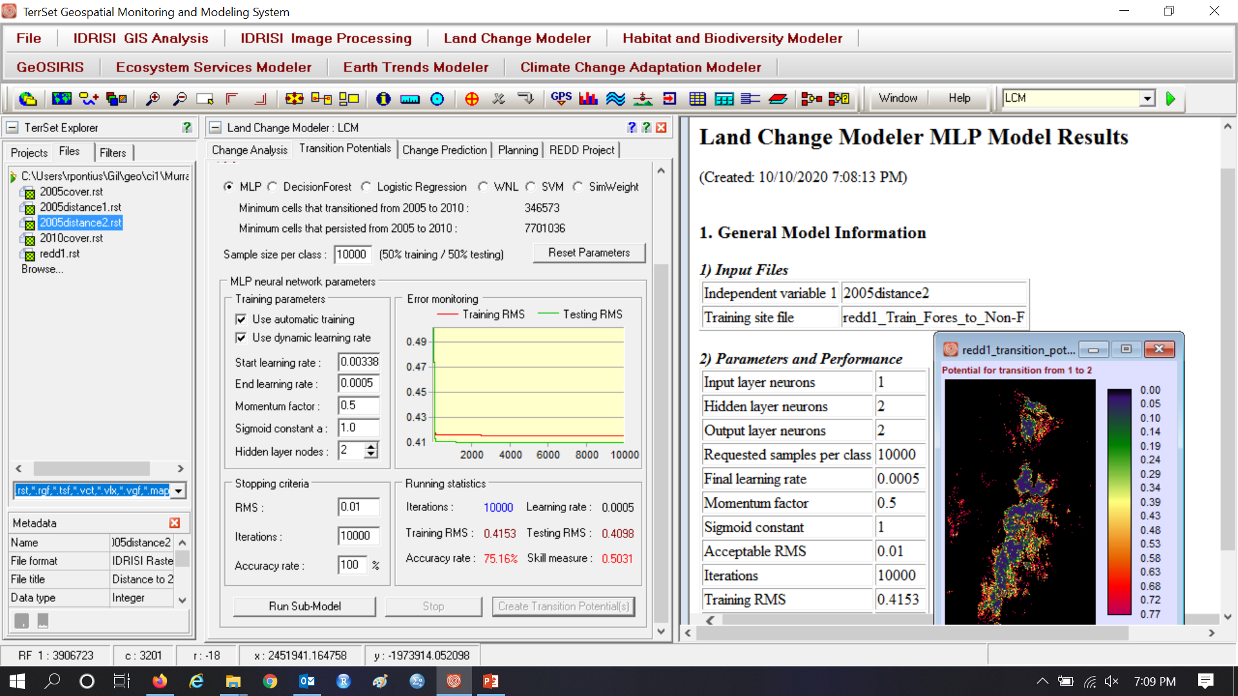
Assignment 8 Create Transition Potential Map

Slide 22
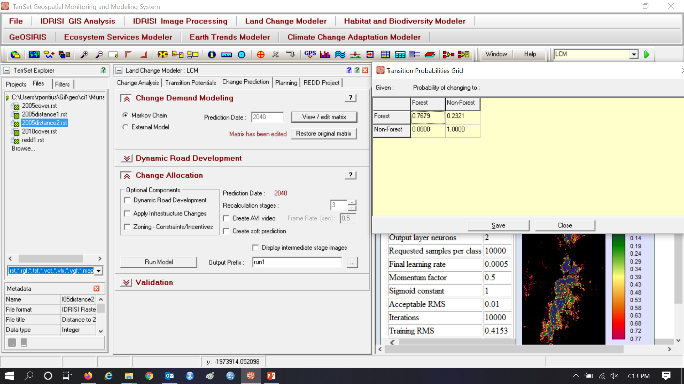
LCM uses the change during calibration to compute the Markov matrix for change from 2010 to 2040

Slide 23
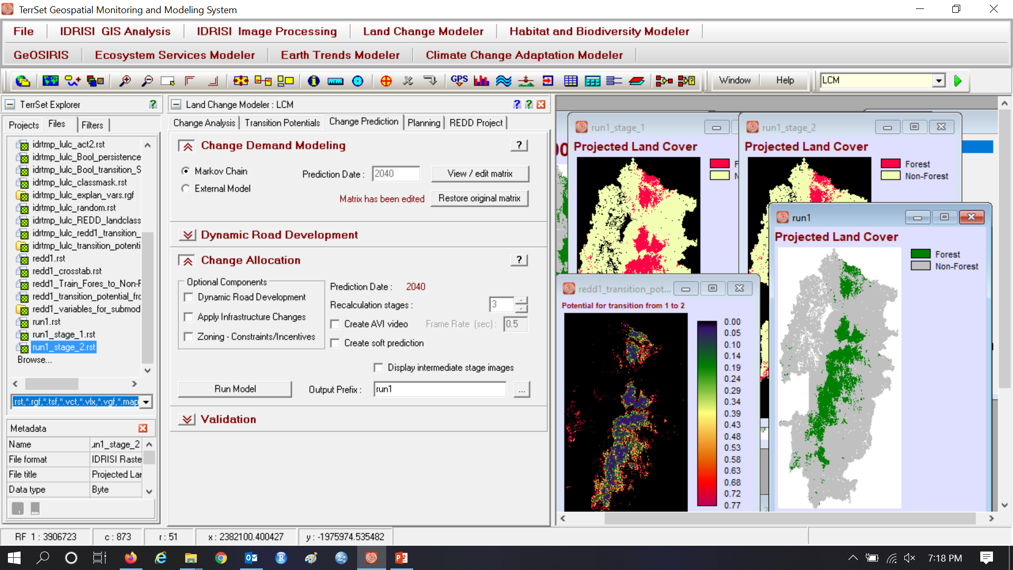
Run 1 makes Projected Land Cover to 2040, which is the baseline extrapolation without protection.

Slide 24
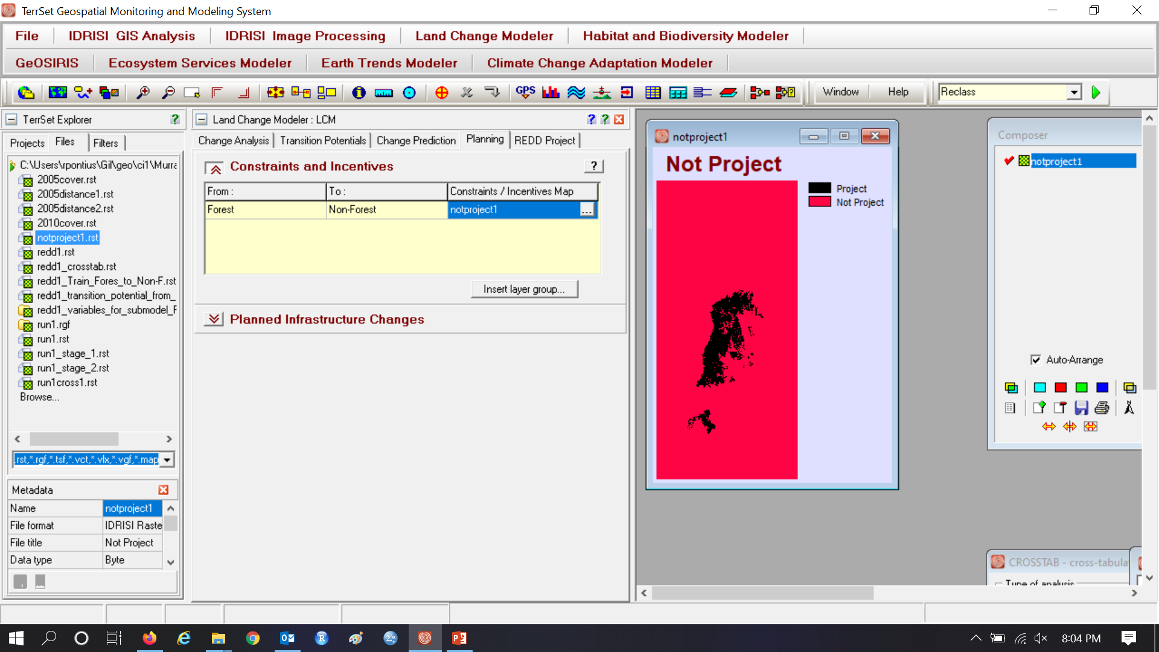
Run 2 includes a constraint to force transition potentials inside project area to zero.

Slide 25
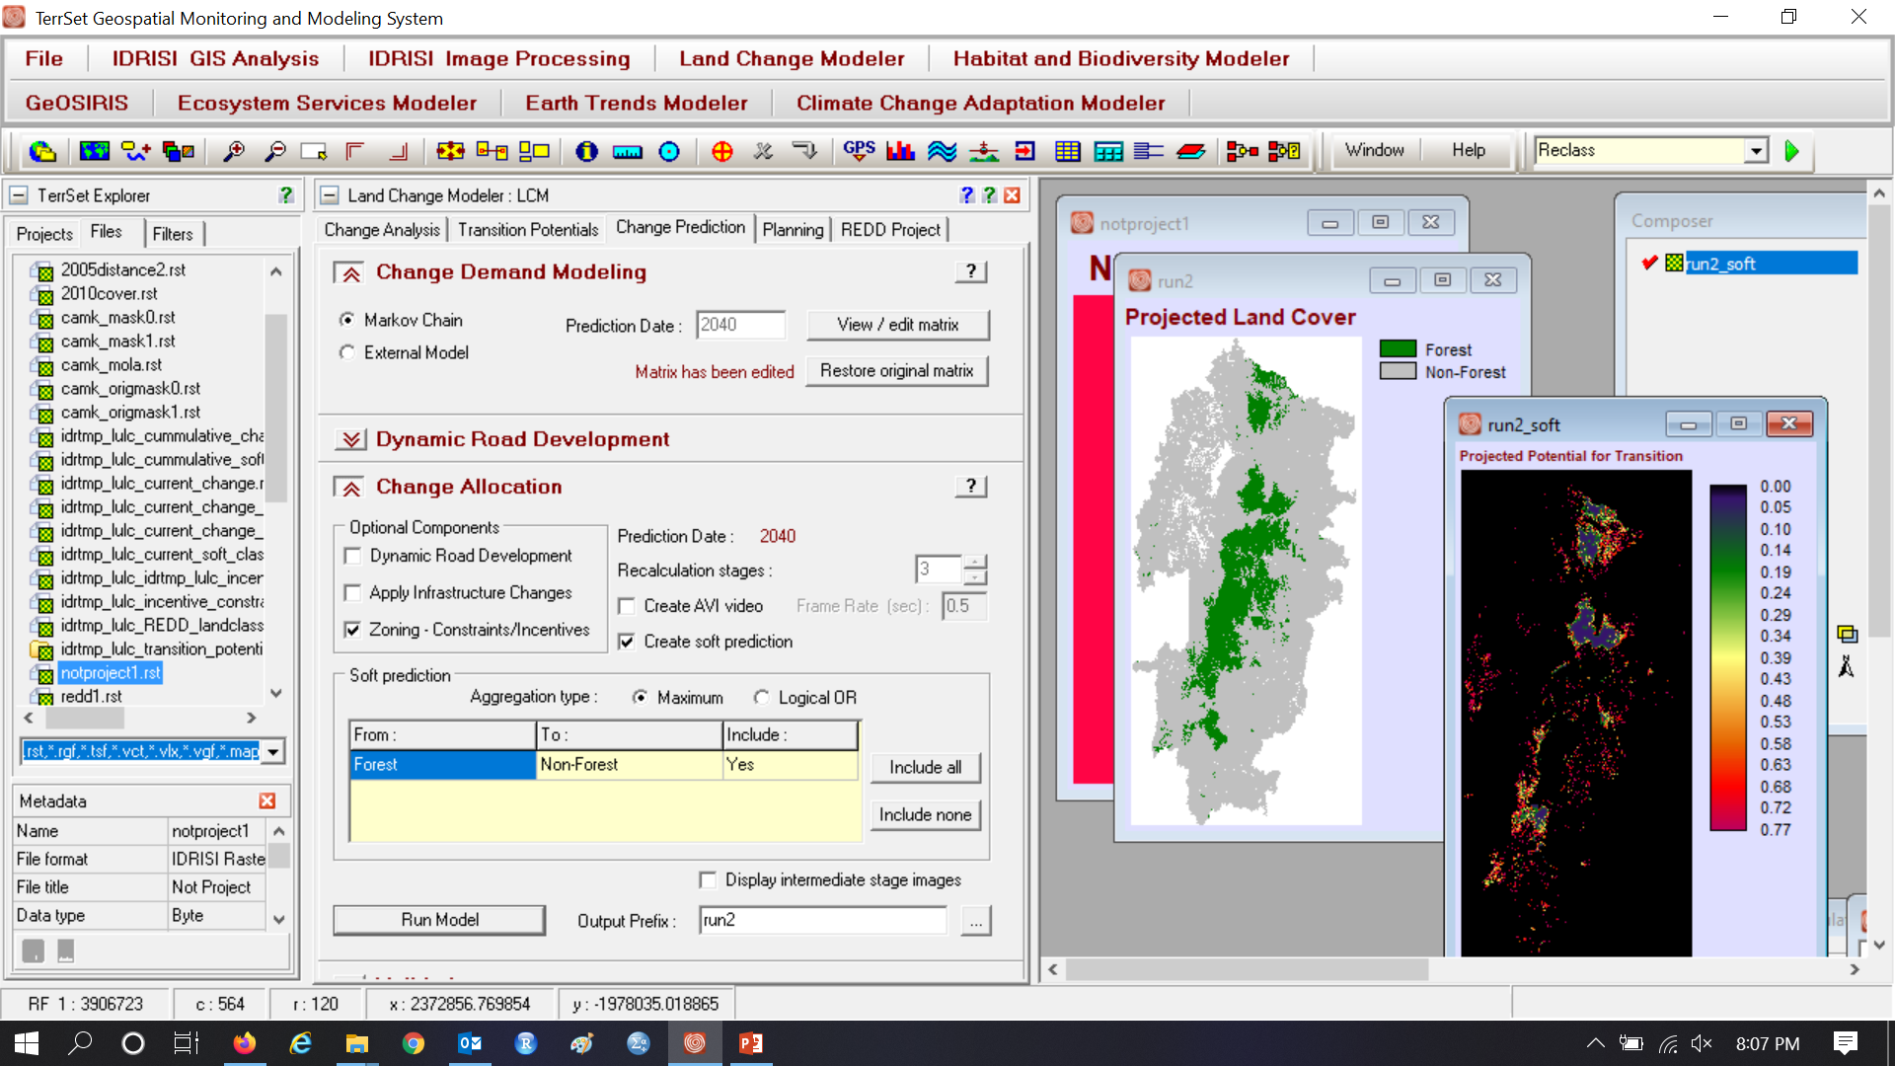
Run 2 includes a constraint to force transition potentials inside project area to zero.

Slide 26
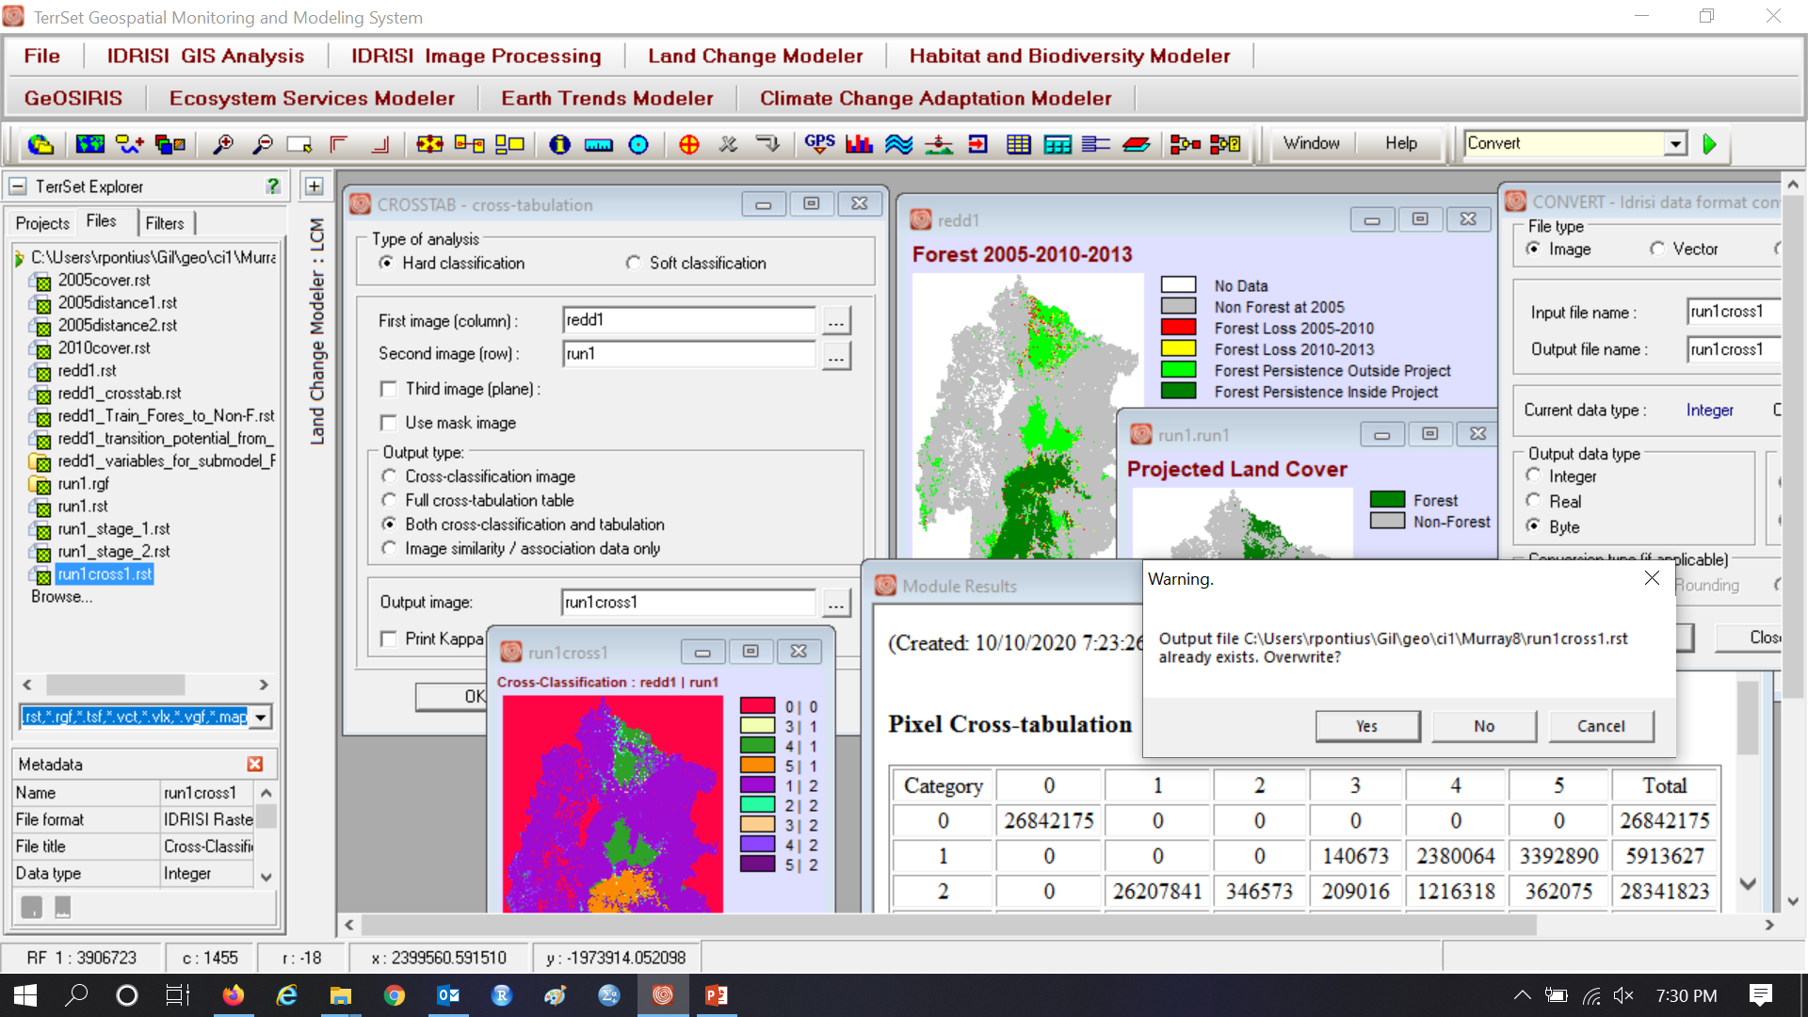
CROSSTAB & CONVERT to Byte to reduce file size for Run 1.

Slide 27
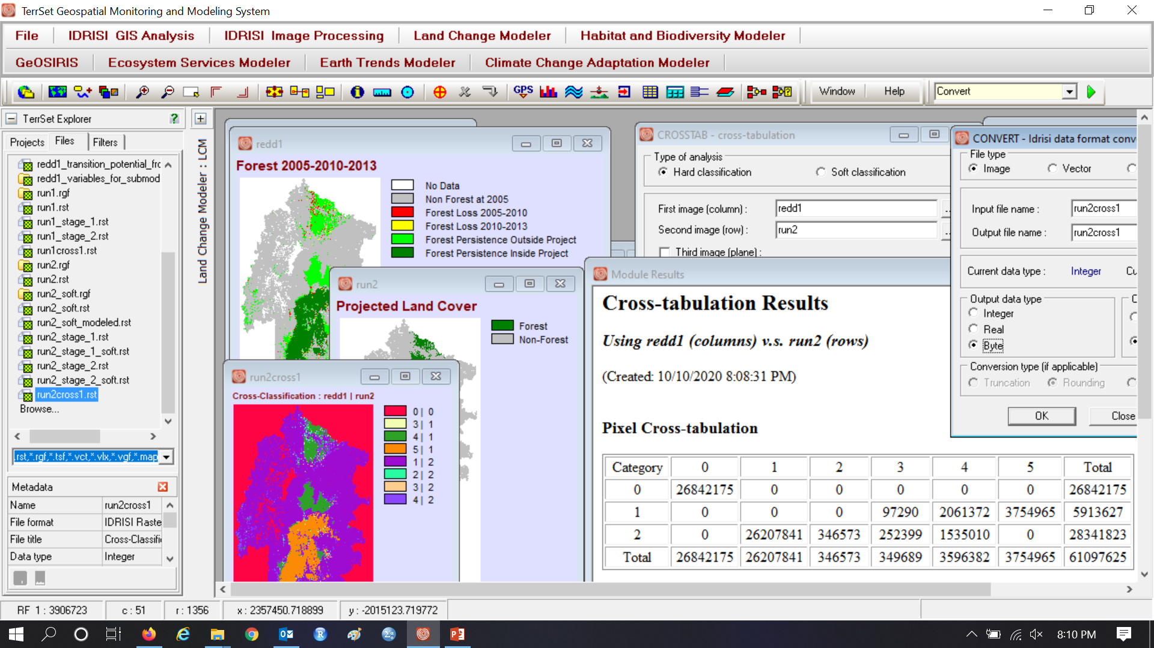
CROSSTAB & CONVERT to byte to shrink file size for Run 2.

Slide 28
Run 1 shows extrapolation without protection, i.e. the baseline. It might be clearer and easier to do a three-map crosstab with 2010cover, 2040cover for run 1, and Boolean Protection.

Slide 29
Run 2 shows extrapolation with protection and same quantity as run 1. It might be clearer and easier to do a three-map crosstab with 2010cover, 2040cover for run 2, and Boolean Protection

Slide 30
CROSSTAB 2005 Cover | run1 | run 2 compares runs where 1 means forest and 2 means non-forest

Slide 31
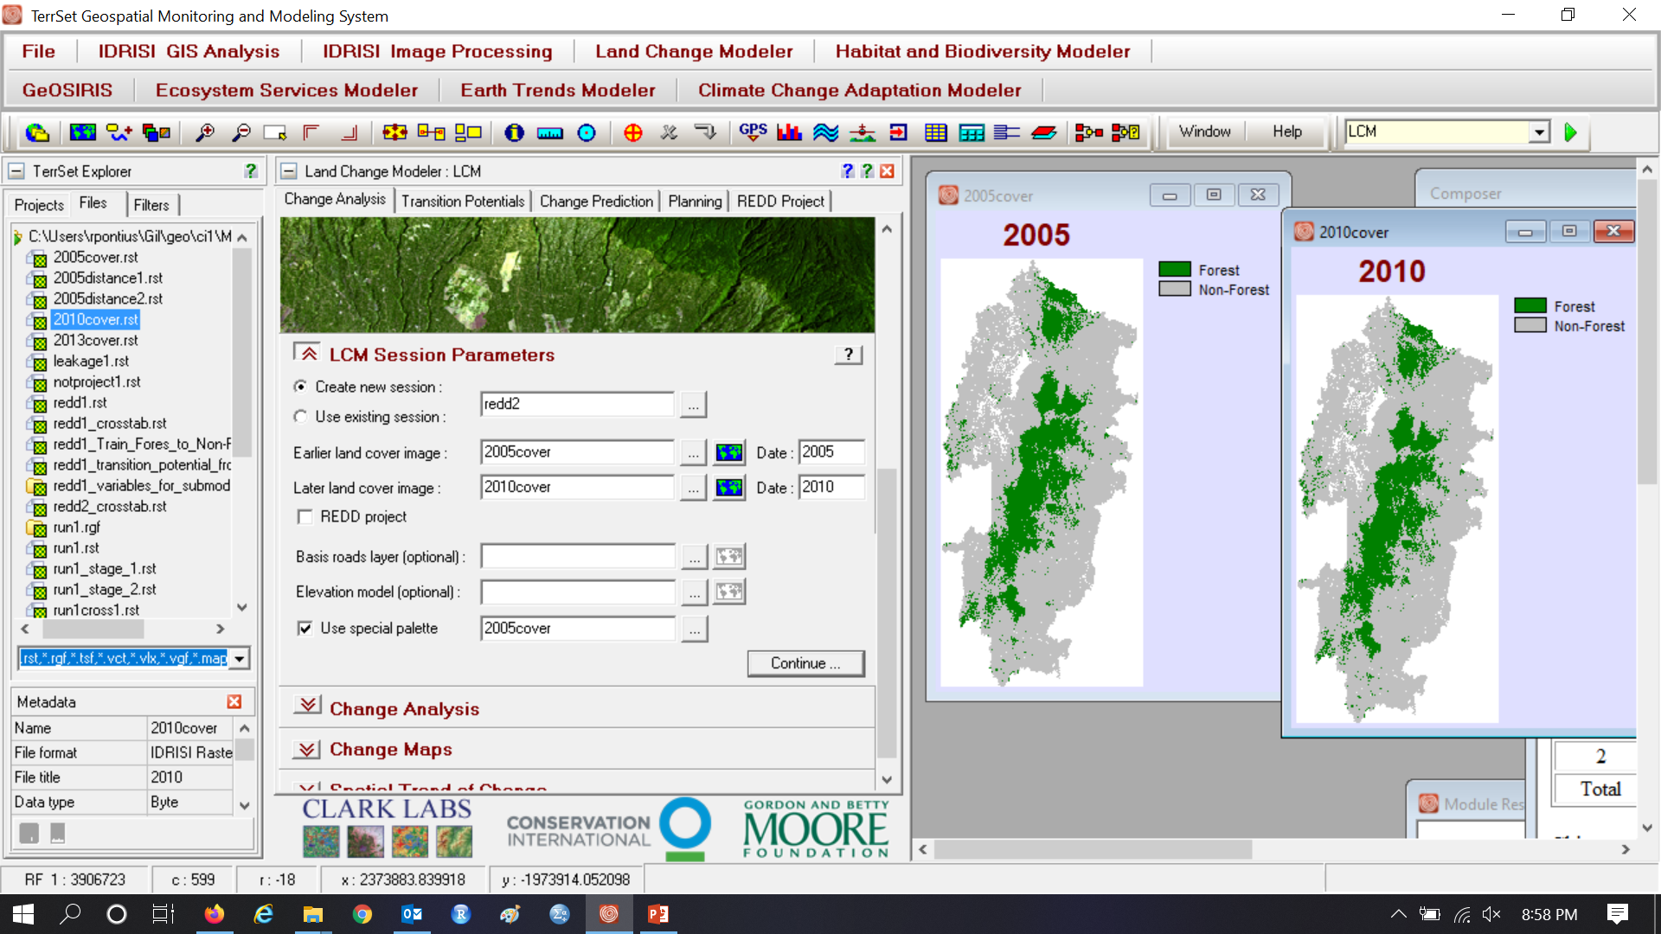
Run 3 for validation without REDD checked

Slide 32
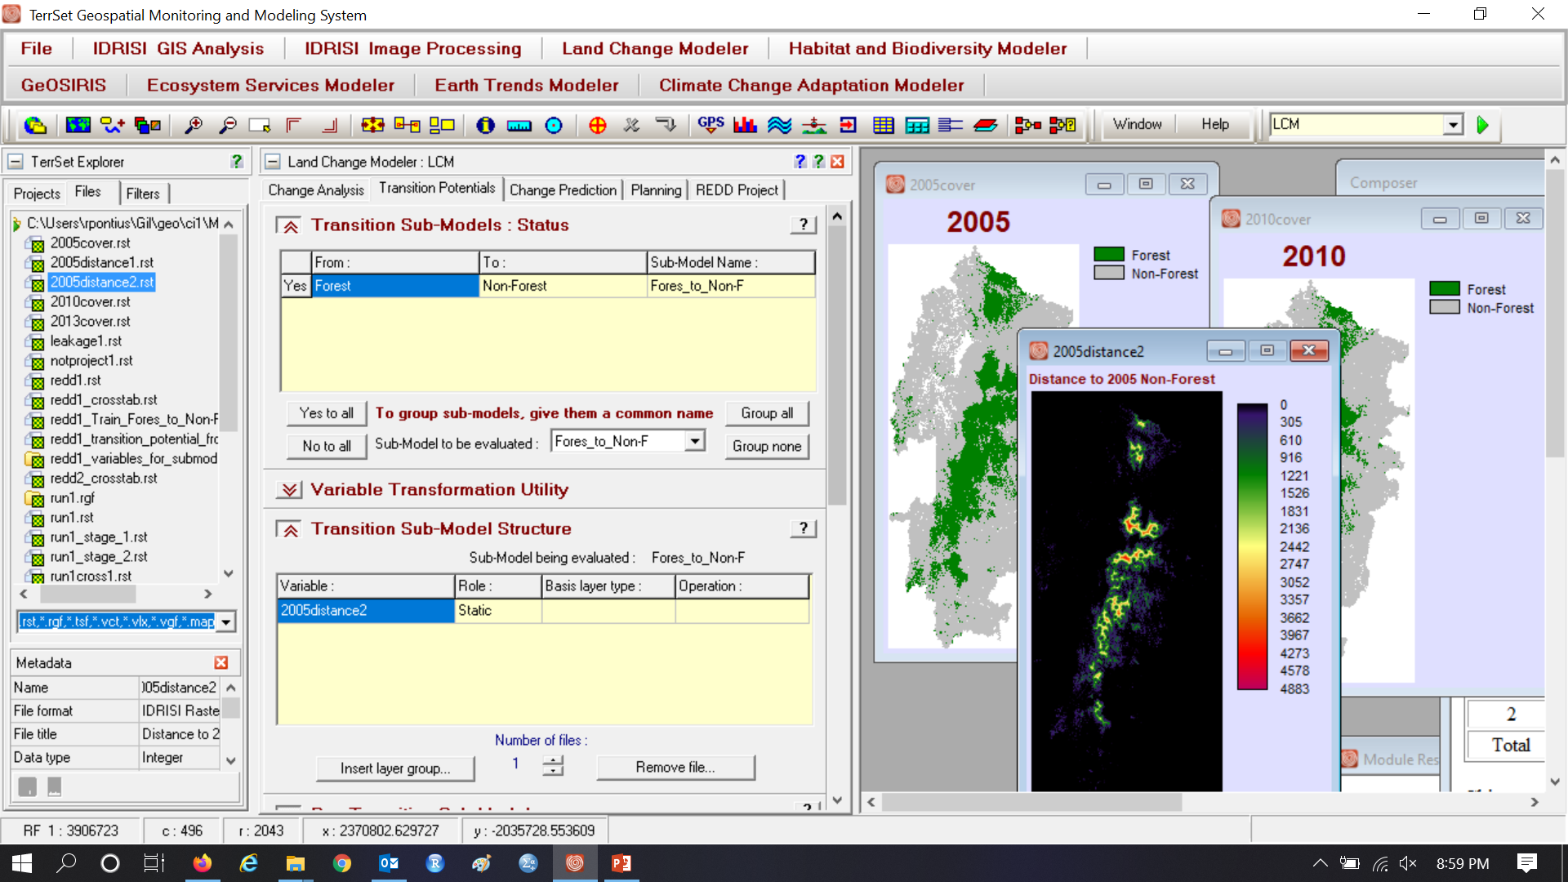
Run 3

Slide 33
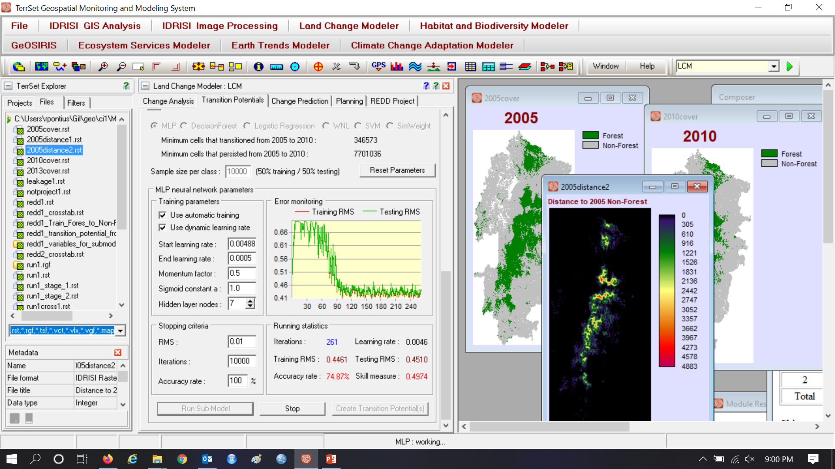
Run 3

Slide 34
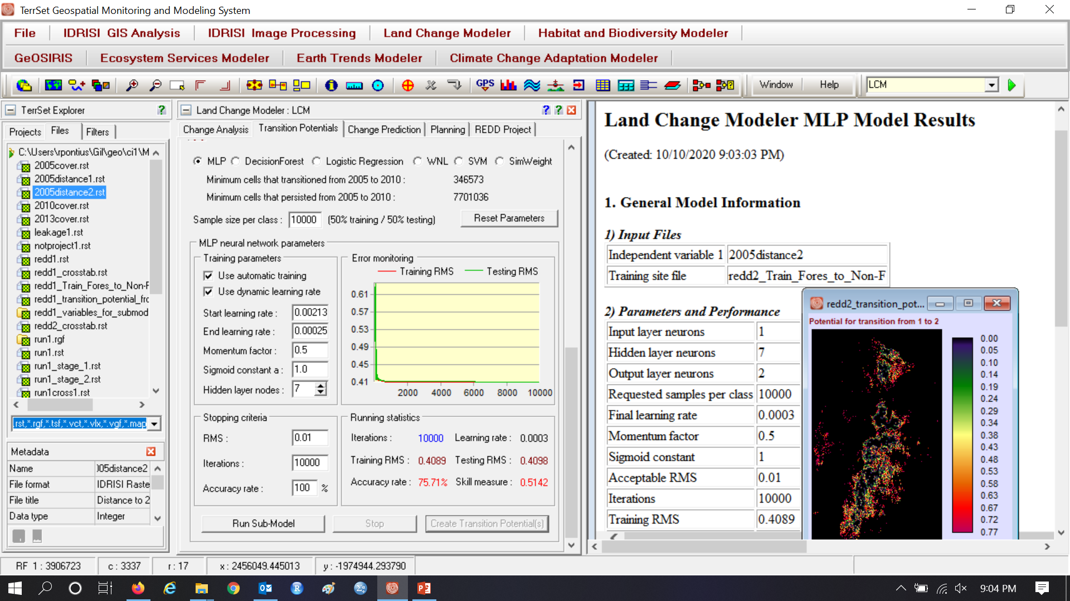
Run 3

Slide 35
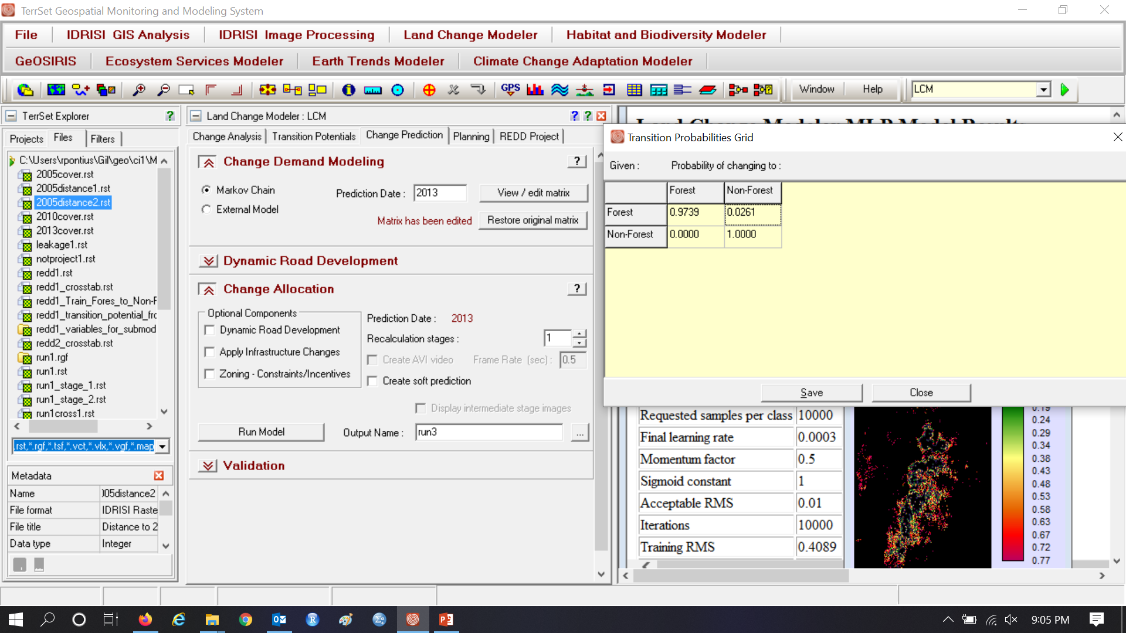
Run 3 extrapolates to 2013 because we have a map at 2013, which we can use for validation.

Slide 36
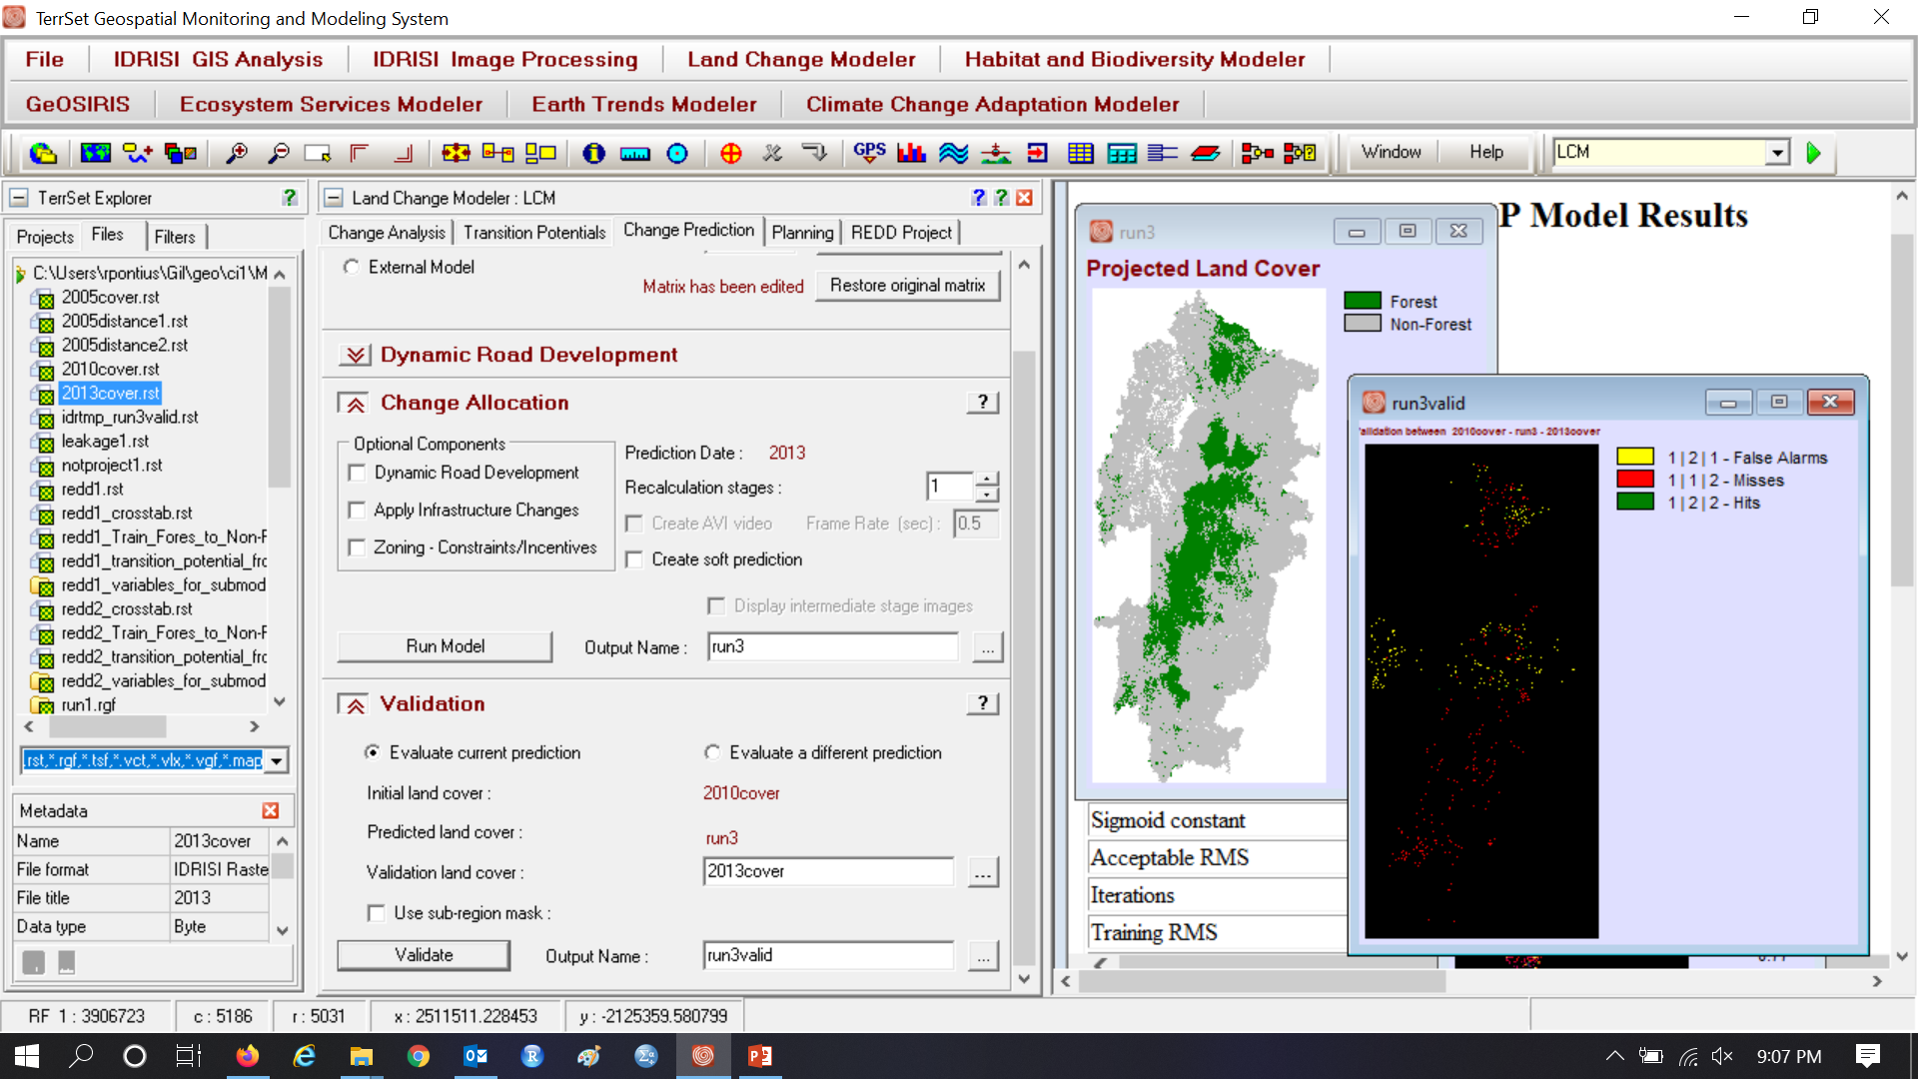
Validation of Run 3. You are better off using CROSSTAB to show and compute Figure of Merit.

Slide 37
The Voluntary Carbon Standard uses FOM
Does the Figure of Merit (FOM) allow you to know whether the simulated change is greater or less than the reference change?
Figure of Merit = Hits / (Misses + Hits + False Alarms)

Slide 38
Figure of Merit = Hits / (Misses + Hits + False Alarms)

